Slide 1


CompSci club
Practice with Conditionals & User Input
These two concepts are so critical that you will get a ton of practice with them today!

Slide 2
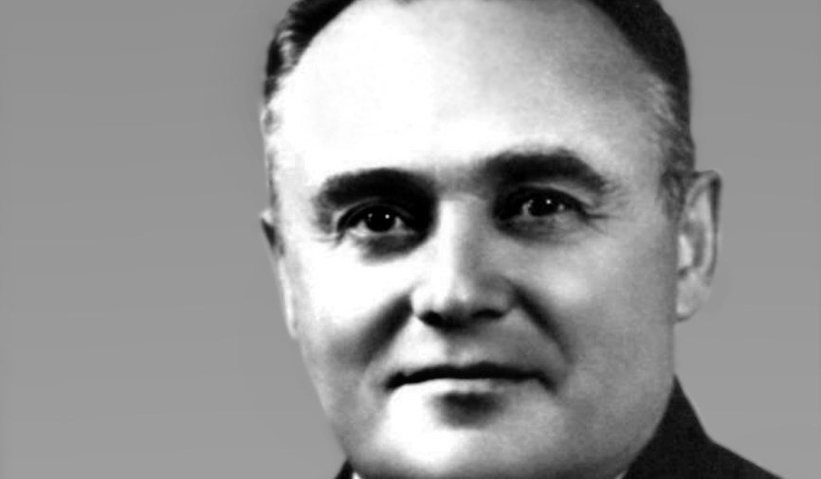
Our person of the day!
Sergei Korolev
With Russians being very dear to our hearts here at CompSci Club (birthday, fyi!), we honor Soviet rocket engineer Sergei Korolev, who was an architect of the Space Race between the U.S. and the USSR
One of Korolev’s biggest contributions is the development of Sputnik 1, which launched on this day in 1957
Sergei would be responsible for pitching the idea of an artificial satellite in 1954
The sputnik (Russian for satellite) travelled at 18,000 mi/hr and reported data for 21 days before burning up in January 1958
Before it did burn up, it rotated the Earth 1,440 times and travelled 43,000,000 mi
Ever wondered for the growth of calculus and science in our schools? You can partially thank (or blame) Sergei!
Rocket Engineer

Slide 3


Roadmap for Today
A deeper look at conditionals
The logic behind conditionals is what is going to aid you in the long run!
Practice with Conditionals
Alas, practice makes perfect! (or as Mr. Setubal likes say, “Perfect Practice makes Perfect”)

Slide 4
Regardless of what language you decide to pursue in the future, this will be of great use!
An explanation of
Conditional Logic

Slide 5
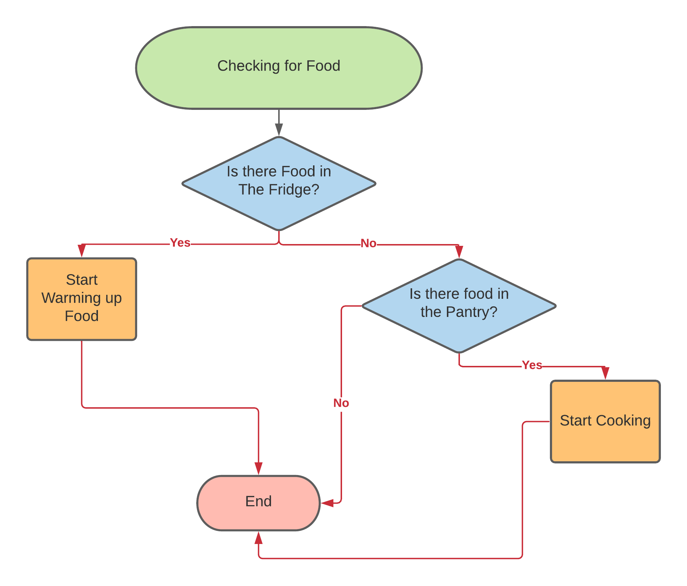
Intro of conditional logic
Let’s pretend you are hungry (maybe you are)
What are some of the decisions you are going to make?
You might go into your fridge, and then make a series of decisions based on that
If you have to nothing in your fridge, you are going to do something else
This is how conditionals work in programming!
Based on if something is True or False, we can fire a certain block of code
You can imagine that we expand this a bit more
Before we give up on having food, we can check if there is anything in the pantry

Slide 6
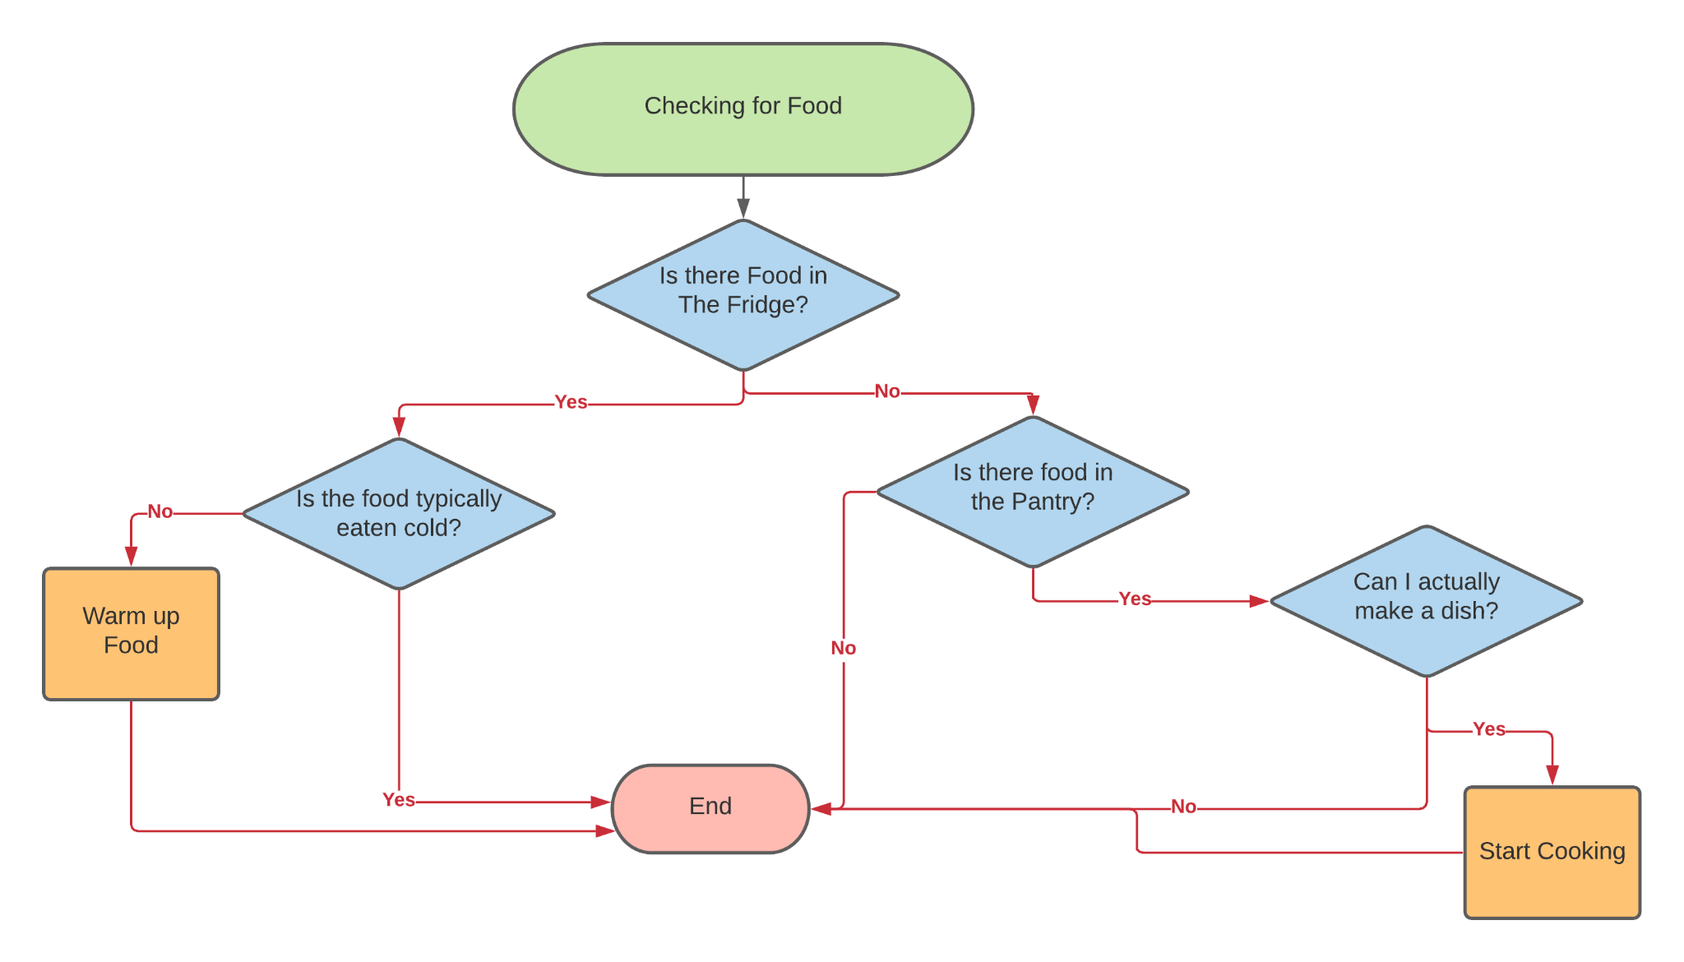
Complex conditional logic
You can probably quickly see how we can scale up this entire process to encapsulate more complex decisions
For example, we can make specific decisions based on what is in the fridge
This would be the equivalent of nesting if statements inside other if statements inside Python
This process help explains why we want to generally go from most to least specific with our if statements
Our else statement acts as a ‘catch all’ that executes only if all of our other conditions return False

Slide 7
Finally, we have some practice for you all!
Practice
With Conditionals

Slide 8
Problem Set One
Exercise One: Spanish Noun Determiner
In Spanish, there is a simple way to determine if a noun is masculine or feminine
If the word begins with “el” or ends with “o”, it’s almost always masculine
If the word ends with “la” or ends with “a”, it’s almost feminine
Given a word in Spanish, determine if it’s masculine or feminine (assume there are no words like el día)
Hint: You need to split up words. Take a look at the .split() method in Python! Pay attention what data type this returns
Handle if the user enters a weird word that doesn’t satisfy either condition!
Exercise Two: Mood Calculator
Let’s have some fun with emojis! Given a word like “sad” or “mad,” print out the corresponding emoji
To find a list of copy & paste emojis, reference this website
Include error handling like before!

Slide 9
Problem Set Two
Exercise One: Homecoming Bouncer v1
You are the bouncer at homecoming (which has been announced next month!)
You are going to check if someone is one the ‘list’ for homecoming
Create a list of first names
Then, using conditionals, check if the name is in the list
If they are on the list, print out a message allowing them in
If they are not, deny them entry
Exercise Two: Homecoming Bouncer v2
Take the above exercise a step further by asking them for their age
If the person is between the ages of 15 and 18, ask them if they are from Raleigh Charter
If they are, let them in! (Though, they technically need to pay $10)
Throughout the entire process, ensure that you have print statements if they do not meet the conditions!

Slide 10
Problem Set Three
Exercise One: A Binary Tree (kind of)
On the right is one of the most important data structures in CS, a Binary Tree (specifically, a Binary Search Tree)
We will hopefully have a full presentation about this later, but know that values on the right are larger than the current value (node) and on the left are smaller
We are going to condense the values of a binary tree to this list: [8,3,1,6,4,7,10,14,13]
Create a program, given a value, and the index of a node value, tells whether the value will be next to and either to the left or right to the node

Slide 11
We will cover the last new topic next week before your first project!
Thank you!
That is all we have for today!

